Slide 1
Software Engineering
Lecture-3

Slide 2
Software Engineering Process Models
Description of a real-world process that abstracts from irrelevant details.
Description which is used to guide or control the execution of a process.
Also known as:
  Software Development Life Cycle Models
  Process Models

Slide 3
Software Development Life Cycle Models
Software life cycle models describe phases of the software cycle and the order in which those phases are executed.
There are tons of models, and many companies adopt their own, but all have very similar patterns.

Slide 4
Process Model
A process model divides a process into phases or working areas.
Phase:
  Time interval in the execution of a process in which activities of a certain kind are executed.
Help the project manager and team to decide:
  What work should be done;
  In what sequence to perform the work.

Slide 5
General Life Cycle Model

Slide 6
General Life Cycle Model
Each phase produces deliverables required by the next phase in the life cycle.
Requirements are translated into design.
Code is produced during implementation that is driven by the design.
Testing verifies the deliverable of the implementation phase against requirements.

Slide 7
Requirements Phase
Business requirements are gathered in this phase.
Meetings with managers, stake holders and users are held in order to determine the requirements.
  Who is going to use the system?
  How will they use the system?
  What data should be input into the system?
  What data should be output by the system?

Slide 8
Requirements Phase contd…
Produce a nice big list of functionality that the system should provide, which describes functions the system should perform, business logic that processes data, what data is stored and used by the system, and how the user interface should work.
The overall result is the system as a whole and how it performs, not how it is actually going to do it.

Slide 9
Design Phase
The software system design is produced from the results of the requirements phase.
Architects have the ball in their court during this phase and this is the phase in which their focus lies.
This is where the details on how the system will work is produced.
Architecture, including hardware and software, communication, software design are all part of the deliverables of a design phase.

Slide 10
Implementation Phase
Code is produced from the deliverables of the design phase during implementation, and this is the longest phase of the software development life cycle.
For a developer, this is the main focus of the life cycle because this is where the code is produced.
Many tools exists (CASE tools) to actually automate the production of code using information gathered and produced during the design phase.

Slide 11
Testing Phase
During testing, the implementation is tested against the requirements to make sure that the product is actually solving the needs addressed and gathered during the requirements phase.
Unit tests and system tests are done during this phase.
Unit tests act on a specific component of the system, while system tests act on the system as a whole.

Slide 12
Process Models
Waterfall
Iterative Development
Incremental
Spiral
RUP
MDA
Agile Software Development

Slide 13
Waterfall Model
The most common and classic of life cycle models, also referred to as a linear-sequential life cycle model.
In a waterfall model, each phase must be completed in its entirety before the next phase can begin.
At the end of each phase, a review takes place to determine if the project is on the right path and whether or not to continue or discard the project.
Unlike general model, phases do not overlap in a waterfall model.

Slide 14
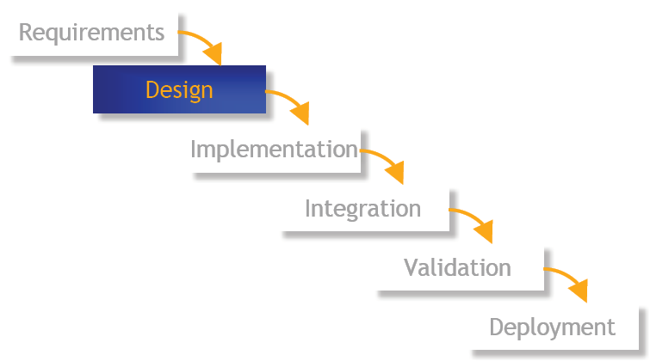
Waterfall Model

Slide 15
Waterfall Model
Requirements Phase:
  Define system services, constraints, and goals by consultation with system users.
Design Phase:
  Partitioning of system into hardware and software
  Define components and relationships
Implementation Phase:
  Realize software components
  Unit testing: test each unit against its specification
Integration Phase:
  individual units are integrated
System testing:
  testing of the overall system
Operation & Maintenance Phase:
  install and put into practical use.
  Correct errors and improve functionality

Slide 16
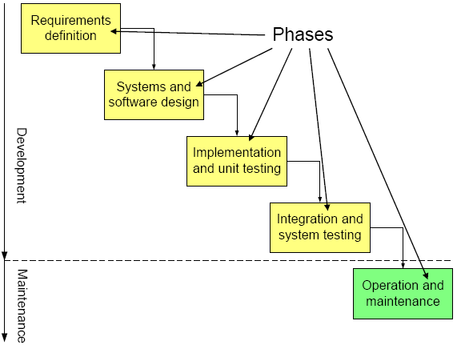

Slide 17
Benefits:
Well-structured engineering process
Easy to use and understand
Every phase produces some document.
Easy to manage due to the rigidity of the model
  each phase has specific deliverables and a review process.
Phases are processed and completed one at a time.
Works well for smaller projects where requirements are very well understood and changes will be rare.

Slide 18
Drawbacks:
Strict phase order not realistic; backtracking and overlapping of activities are usually required.
Late feedback from the customer.
No working software is produced until late during the life cycle.
High amounts of risk and uncertainty.
Poor model for complex and object-oriented projects.
Poor model for long and ongoing projects.

Slide 19
Enhancements of Waterfall Model
Extended waterfall model
  Extends waterfall model with backtracking to previous phases
Incremental development model
  System is not developed in a big-bang-fashion; rather, it is developed in increments.
Spiral model
  Incremental development model with specific focus on risk analysis
Working area model
  Divide software process into working areas (logically related activities) rather than phases (time intervals)
  Defines only the activities to be executed and their logical relationships, but not their temporal order

Slide 20
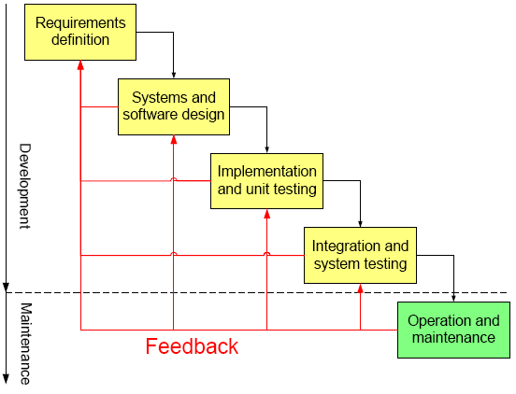
Extended Waterfall Model (with backtracking)

Slide 21
Iterative Development
The problems with Waterfall model demanded a more faster and flexible development method.
With Iterative development, the project is divided into small parts.
This allows the development team to demonstrate results earlier on in the process and obtain valuable feedback from system users.
Often, each iteration is actually a mini-Waterfall process with the feedback from one phase providing vital information for the design of the next phase.

Slide 22
Iterative Development
Domain engineering:
  Get acquainted with domain of discourse
Requirements
Build baseline system:
  Build minimal useful system
Iterate:
  Extend with well-defined functionality
Roll-out and documentation

Slide 23
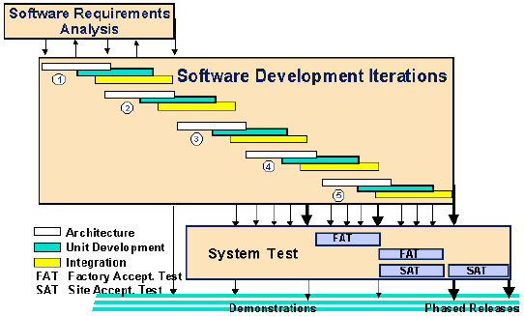
Iterative Model

Slide 24
Characteristics
Frequently produce working versions of the final system.
Implement subsets of required features.
Faithful to the demands of the final system.
Fully integrated.
Carefully tested.
Be a part of the final delivery.

Slide 25
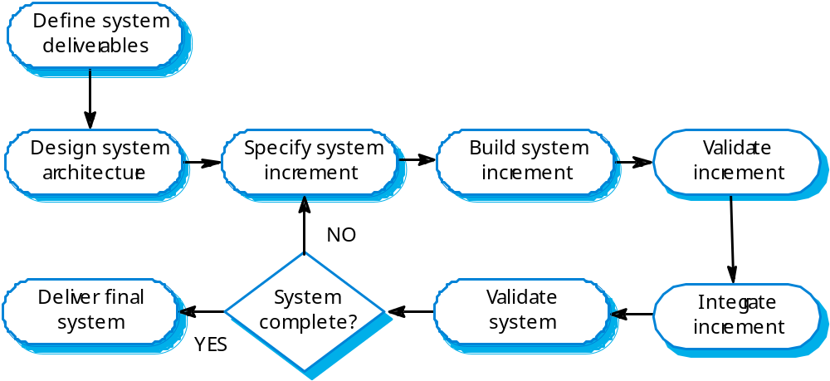
Iterative Development Process

Slide 26
Example: MS Word
First increment:
  basic file management, editing, document production function.
Second increment:
  sophisticated editing and document production capabilities.
Third increment:
  spelling and grammar checking functions
Fourth increment:
  advanced page layout capability

Slide 27
Challenges
The user community needs to be actively involved throughout the project.
  While this involvement is a positive for the project, it is demanding on the time of the staff and can add project delay.
Communication and coordination skills take center stage in project development.
Informal requests for improvement after each phase may lead to confusion.
The user feedback following each phase may lead to increased customer demands.
  As users see the system develop, they may realize the potential of other system capabilities which would enhance their work.

Slide 28
Problems
There is no documentation to demonstrate what has been done.
Continual change tends to corrupt software structure making it more expensive to change and evolve to meet new requirements.

Slide 29
When to use
When the software can be broken into increments and each increment represents a solution.

Slide 30
Variations on Iterative Development
Prototyping
Spiral
Exploratory
The Reuse Model

Slide 31
Common Experience
Waterfall model is good reference model for documenting the finished product, rarely a good development model.
Iterative development (baseline, then well-defined extensions) is good for deadline-driven projects: at any point there is a finished product.

Slide 32
Prototyping Model
For some large systems, incremental iterative development and delivery may be impractical; this is especially true when multiple teams are working on different sites.
Prototyping, where an experimental system is developed as a basis for formulating the requirements may be used. This system is thrown away when the system specification has been agreed.

Slide 33
Prototyping Model
Used when
  Customer defines general objectives but doesn’t identify detailed requirements
  Developer may be unsure of algorithm efficiency, and other UI issues.
  Focus is on understanding the requirements
Customer and developer should meet and agree on using prototyping model.
Prototype is initial system, it is discarded and actual quality software is built.

Slide 34
Prototyping vs. Iterative
The objective of iterative development is to deliver a working system to end-users. The development starts with those requirements which are best understood.
The objective of throw-away prototyping is to validate or derive the system requirements. The prototyping process starts with those requirements which are poorly understood.

Slide 35
Prototyping Model
Start with what is known about requirements.
Do a quick design.
Build the prototype by focusing on what will be seen by the user.
Use the prototype to show the user and help refining requirements.

Slide 36
Prototyping Model: Phases
Requirements Gathering
  Define overall objectives and identify known requirements
Quick Design
  Representation of inputs, outputs
Prototype Construction
  “First” system built
Prototype Evaluation
  By customer, to refine the requirements
Iterations
  To satisfy customer requirements

Slide 37
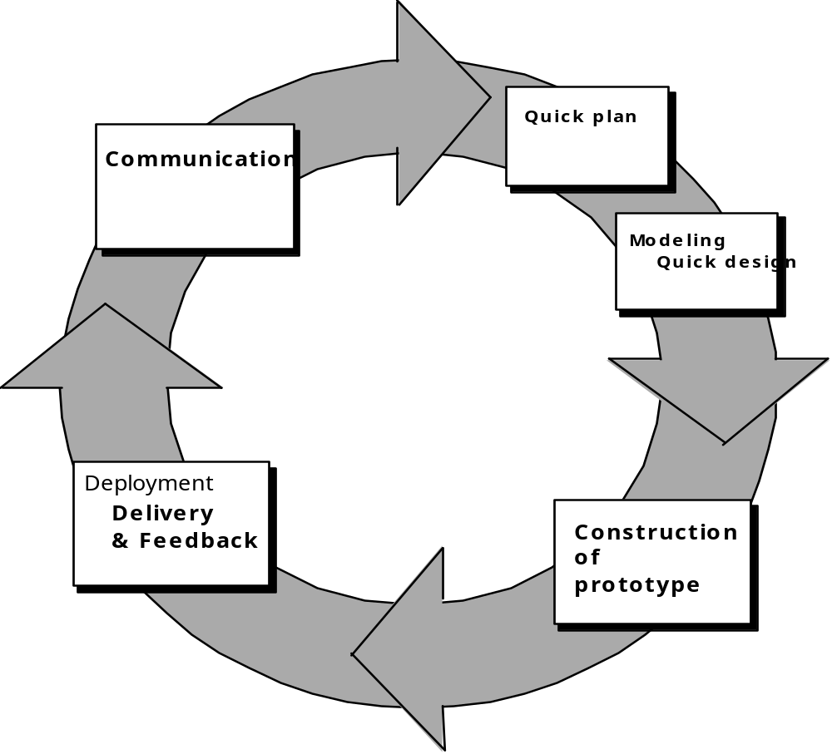
Prototyping Model

Slide 38
Drawbacks
Overall software quality and maintainability not considered, customer sees it as working model, demands few fixes.
Implementation compromises, developer is in a hurry.
Inappropriate OS/language may be used, inefficient algo may be used.

